Slide 1
HW – The tower of hanoi
The objective of the puzzle is to move the entire stack to another rod, obeying the following simple rules next pages:
Disks
A
B
C

Slide 2
HW – The tower of hanoi
Move rules:
Only one disk can be moved at a time.
Each movement consists of taking the upper disk from one of the stacks and placing it on top of another stack or on an empty rod.
No larger disk may be placed on top of a smaller disk.

Slide 3
HW – The tower of hanoi
We suppose that:
The smallest disk is 1, the largest one is N.
The poles name “A B C” sequentially.
We always want to move all disks from A to C
Input : A number(N, disks on A pole at the beginning)
Output: The moving process of the disks

Slide 4
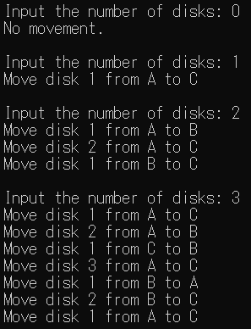
HW - Reference output

